Slide 1
Capstone Project說明
F74116209 張育銓

Slide 2
https://www.ypppt.com/
目錄
CONTENTS
1
TASK1
Data Processing
2
TASK2
Classification
3
TASK3
Regression
4
TASK4
Recommendation Systems

Slide 3
01
TASK1
Data Processing

Slide 4
TODO 1: Read the data and Fill your dataset
Used pandas.read_csv() to load the dataset from a TSV file
Used df.info() to display column information and non-null counts
Used df.head() to preview the first few rows of data
Used df.isnull().sum() to count missing values in each column
Used df.dropna() to remove rows containing null values
Verified missing values post-cleaning using df_cleaned.isnull().sum()
Used df_cleaned.info() to confirm the updated structure

Slide 5
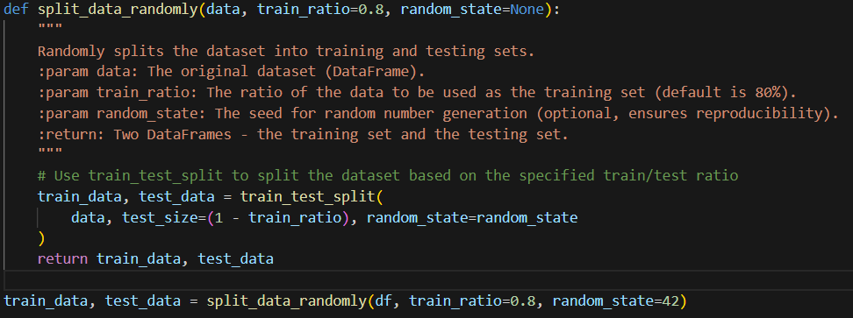
TODO 2: Split the data into a Training and Testing set
Used sklearn.model_selection.train_test_split to split the dataset into training (80%) and testing (20%) subsets

Slide 6
TODO 3: Extracting Basic Statistics
calculate_average_rating(data)
Computes the mean star rating
calculate_verified_fraction(data)
Calculates the fraction of verified purchases
calculate_total_users(data)
Counts the total unique users
calculate_total_items(data)
Counts the total unique products
calculate_five_star_fraction(data)
Computes the proportion of 5-star reviews

Slide 7
02
TASK2
Classification

Slide 8
TODO 1: Define the feature function
Used data['review_body'].fillna('').apply(len).values to compute the length of each review, ensuring missing values were replaced with an empty string
Extracted data['star_rating'].values as a feature
Combined review length and star ratings into a single feature matrix using np.vstack((review_length, star_rating)).T
Converted the verified_purchase column to integers using data['verified_purchase'].astype(int).values

Slide 9
TODO 2: Fit your model
Used LogisticRegression() to initialize the Logistic Regression model
Used model.fit(X_train, y_train) to train the Logistic Regression model on the training data
Used model.predict(X_test) to make predictions on the test data using the trained model

Slide 10
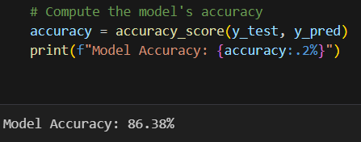
TODO 3: Compute Accuracy of Your Model
Used accuracy_score(y_test, y_pred) to compute the model's accuracy

Slide 11
TODO 4: Finding the Balanced Error Rate
Calculated True Positives (TP), False Positives (FP), True Negatives (TN), and False Negatives (FN) using confusion_matrix
Computed Sensitivity (Recall for the positive class) using sensitivity = tp / (tp + fn)
Computed Specificity (Recall for the negative class) using specificity = tn / (tn + fp)
Calculated the Balanced Error Rate using ber = compute_ber(y_test, y_pred)

Slide 12
03
TASK3
Regression

Slide 13
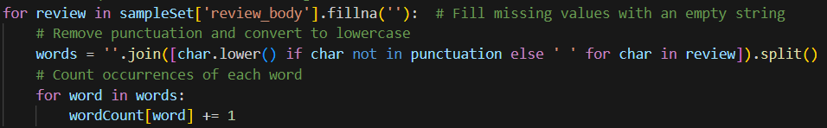
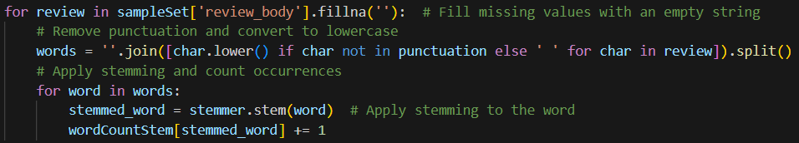
TODO 1: Unique Words in a Sample Set
Without Stemming
Removed punctuation and converted text to lowercase
Counted occurrences of each word using collections.defaultdict
With Stemming
Applied stemming using PorterStemmer
Counted stemmed words using wordCountStem

Slide 14

TODO 2: Evaluating Classifiers
Initialized a Ridge Regression model with alpha=1.0 for regularization
Split data into training and validation sets using train_test_split
Trained the Ridge Regression model
Predicted star ratings on the validation set
Computed MSE using mean_squared_error from sklearn.metrics

Slide 15
04
TASK4
Recommendation Systems

Slide 16
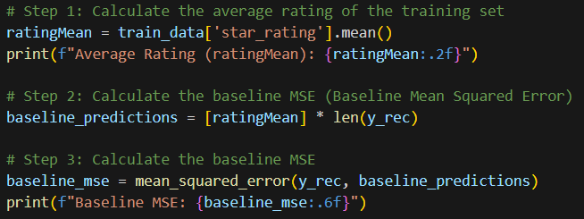
TODO 1: Calculate the ratingMean
Computed the average rating of the training data using ratingMean = train_data['star_rating'].mean()
Predicted ratings for all items using the baseline mean
Evaluated the baseline MSE using baseline_mse = mean_squared_error(y_rec, baseline_predictions)

Slide 17
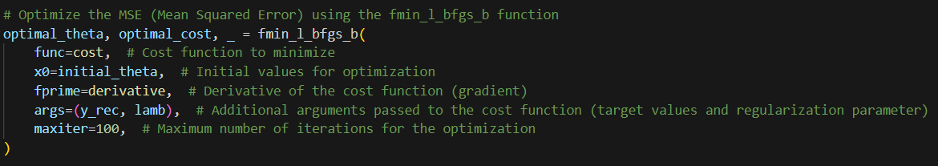
TODO 2: Optimize
Utilized scipy.optimize.fmin_l_bfgs_b for optimization
Updated alpha, userBiases, and itemBiases using the optimized theta
Output the optimized global bias (alpha) and final MSE

Slide 18
THANK YOU!

